Slide 1

HI6050 Capstone: Comprehensive Topic Selection and Supplementary Document
Supervisor: Dr. Farshid Keivanian
Session 4: Preparation for Group Research Proposal: Literature Review, Research Question, Tools, Languages & Early Prototyping: Literature Review, Research Question, Tools, Languages, Early Prototyping, Draft & Submit Research Proposal

Slide 2
Session 4’s outline
Weekly Task Breakdown & Milestones
Preparation for Group Research Proposal: Literature Review, Research Question, Tools, Languages & Early Prototyping: Literature Review, Research Question, Tools, Languages & Early Prototyping
Preparation for Group Research Proposal: Draft & Submit Research Proposal
Group Progress Presentation – Overview of Progress at least 2 min

Slide 3
Weekly Task Breakdown & Milestones
Week | Action
Week 1-2 | Form groups, confirm your campus group number, select topic via Blackboard sheet.
Week 3 | Begin literature review + define project scope and research question.
Week 4 | Finalize tools, datasets, programming language; create basic prototypes/mockups.
Week 5 | Draft your research proposal + submit it.
Week 6 | Submit Research Proposal (25%)
Week 7-10 | Start project build (coding/analysis), write sections of final report.
Week 11 | Submit Final Report (45%)
Week 12 | Present & Demo Project (30%)

Slide 4
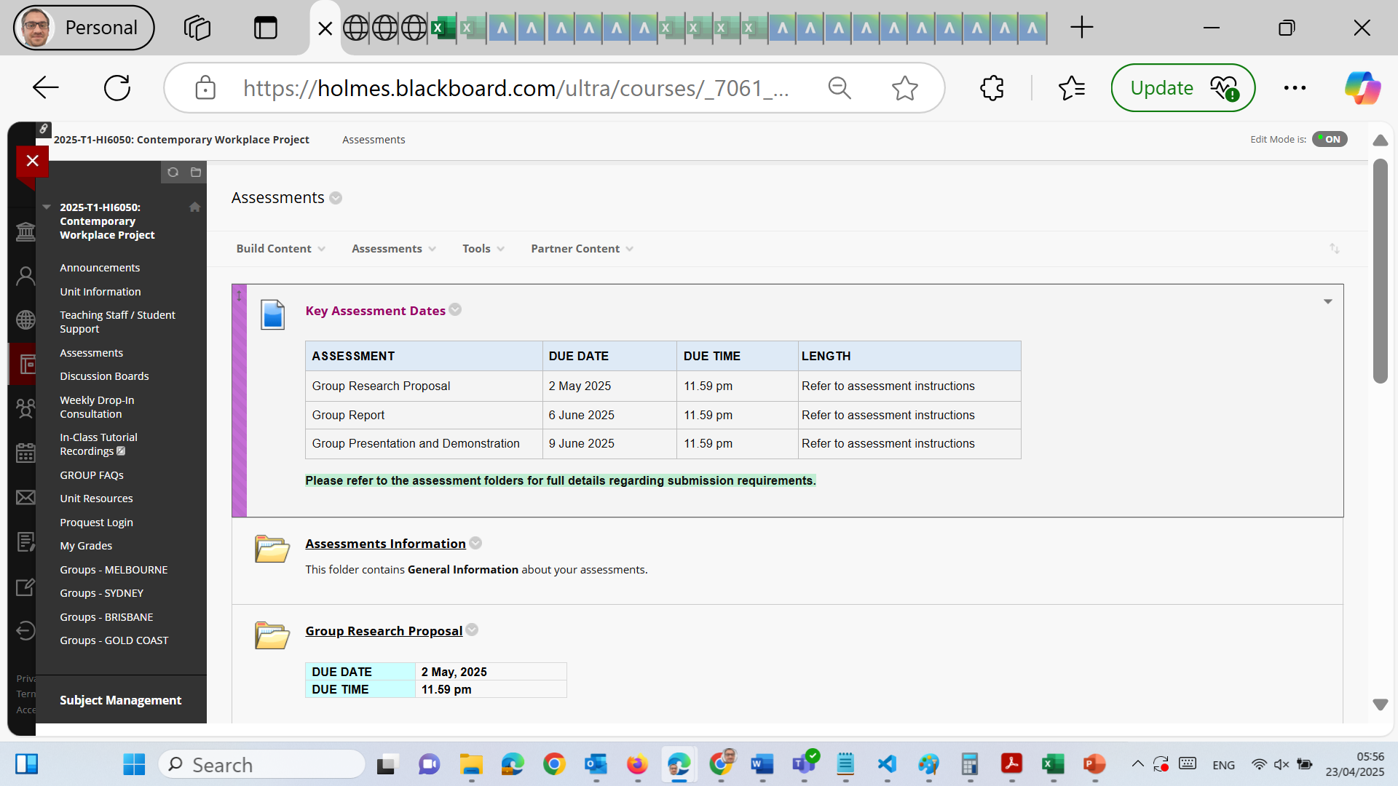
Preparation for Group Research Proposal: Literature Review, Research Question, Tools, Languages & Early Prototyping

Slide 5
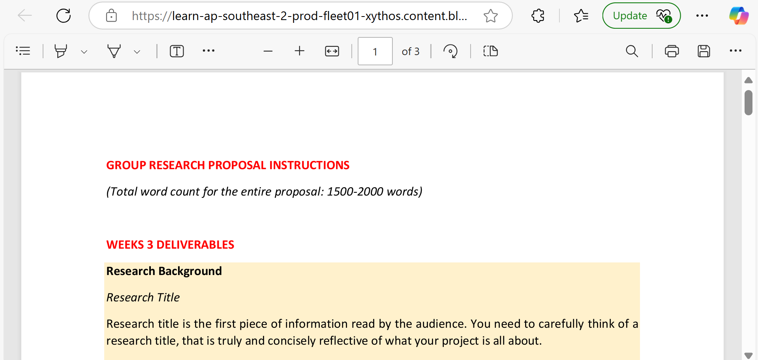
Preparation for Group Research Proposal: Literature Review, Research Question, Tools, Languages & Early Prototyping

Slide 6
Preparation for Group Research Proposal: Literature Review, Research Question, Tools, Languages & Early Prototyping
Literature Review & Research Question (Session 1)
Goals:
Start literature review
Define research problem, objectives, scope
Formulate a research question

Slide 7
Preparation for Group Research Proposal: Literature Review, Research Question, Tools, Languages & Early Prototyping
What to Do:
Use the topic selected (e.g., “AI in cybersecurity”) to:
Search academic papers (Google Scholar, ProQuest, IEEE)
Read systematic reviews, meta-analyses, and case studies
Draft:
3–5 objectives
A well-defined scope (what’s in, what’s out)
A single focused research question

Slide 8
Preparation for Group Research Proposal: Literature Review, Research Question, Tools, Languages & Early Prototyping
❌ What to Avoid:
Copy-pasting abstracts into your review
Writing a broad/general research question
Ignoring peer-reviewed sources
Tips:
Use a literature review matrix (tool: Excel or Notion)
Ensure the research question aligns with the topic
Use frameworks (e.g., “PICO”, “SMART”) to refine the question

Slide 9
Preparation for Group Research Proposal: Literature Review, Research Question, Tools, Languages & Early Prototyping
Tools, Languages & Early Prototyping (Session 2)
Goals:
Select the tools/languages/platforms
Choose any datasets (if applicable)
Begin basic prototyping or system design (if technical)

Slide 10
Preparation for Group Research Proposal: Literature Review, Research Question, Tools, Languages & Early Prototyping
What to Do:
Identify:
Programming language (e.g., Python, PHP, Java)
Tools (e.g., Power BI, Tableau, HTML/CSS/JS, Firebase)
Dataset source (e.g., Kaggle, government portals)
Create:
UI wireframes or diagrams (Figma, Canva)
Conceptual database schema (ERD, MySQL Workbench)

Slide 11
Preparation for Group Research Proposal: Literature Review, Research Question, Tools, Languages & Early Prototyping
❌ What to Avoid:
Skipping tool selection thinking it’s “only literature”
Choosing too many technologies
Forgetting to check data licensing and relevance

Slide 12
Preparation for Group Research Proposal: Literature Review, Research Question, Tools, Languages & Early Prototyping
Tips:
Use existing academic project repositories for reference
Tools should match your research question and project scope
For non-coding teams, tools can include data visualization platforms

Slide 13
Preparation for Group Research Proposal: Draft & Submit Research Proposal
Goals:
Finalize all parts of the proposal
Submit Word (.docx) file with cover sheet
What to Include in Proposal:
Title
Abstract
Introduction
Problem Background
Research Question
Objectives
Project Scope
Research Methodology (Literature Review)
Preliminary Literature Summary
Timeline (Gantt chart)
References

Slide 14
Preparation for Group Research Proposal: Draft & Submit Research Proposal
❌ What to Avoid:
Generic or copied abstract
Not citing references properly (Holmes Harvard style)
Missing group members on cover sheet
Tips:
Draft together in Google Docs for live feedback
Submit only from laptop/desktop
Use MS Word format (.docx), no PDFs or Pages

Slide 15
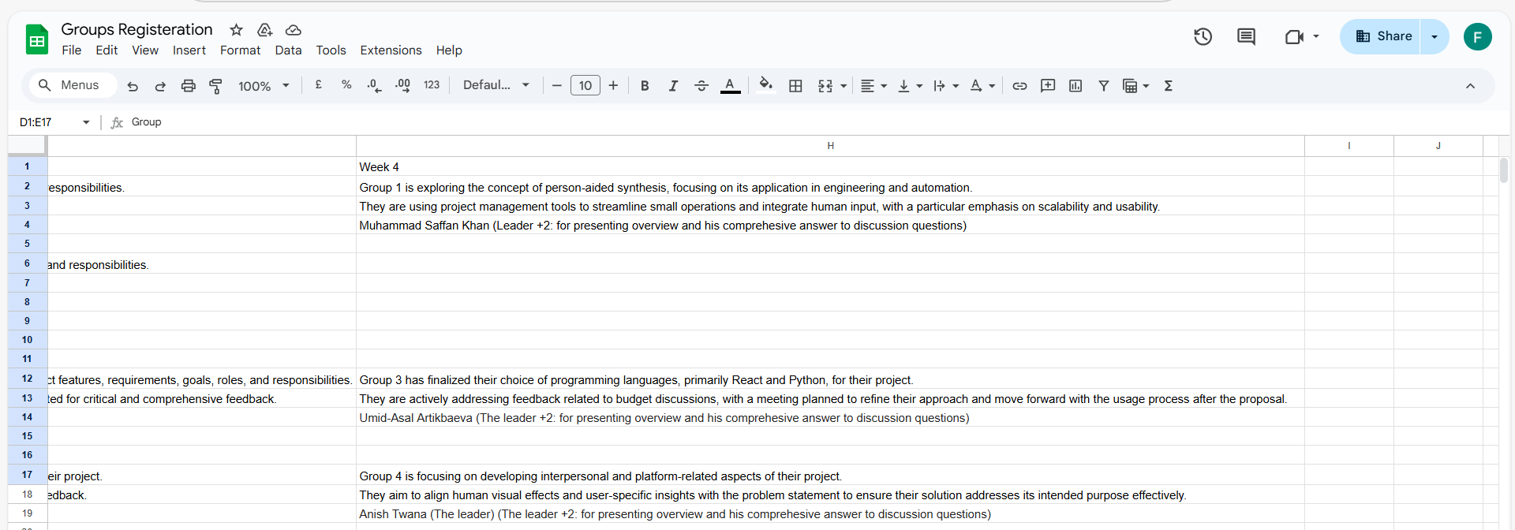
Group Progress Presentation – Overview of Progress at least 2 min

Slide 16
Thank You
Need Help? Send an email or ask during the tutorial session.
Good luck with your capstone journey!
Dr. Farshid Keivanian Capstone Project Supervisor farshid.keivanian@holmes.edu.au

